Slide 1
Signed, Sealed and Delivered
www.kevinwearls.com

Slide 2
Sealing in forehead
“Then I saw another angel ascending from the east, having the seal of the living God.
And he cried with a loud voice to the four angels to whom it was granted to harm the earth and the sea, saying,
“Do not harm the earth, the sea, or the trees till we have sealed the servants of our God on their foreheads.”
And I heard the number of those who were sealed. One hundred and forty-four thousand of all the tribes of the children of Israel were sealed:” (Revelation 7:2–4, NKJV)

Slide 3
Signed: Committed
. . . then Moses stood in the entrance of the camp, and said, “Whoever is on the Lord’s side—come to me!” And all the sons of Levi gathered themselves together to him. . .
So the sons of Levi did according to the word of Moses. And about three thousand men of the people fell that day. Then Moses said, “Consecrate yourselves today to the Lord, that He may bestow on you a blessing this day, for every man has opposed his son and his brother.”
(Exodus 32:25–29, NKJV)

Slide 4
Theme of Book:
“Holy +” used over 150 times in Leviticus
“And you shall be holy to Me, for I the Lord am holy, and have separated you from the peoples, that you should be Mine.”
(Leviticus 20:26, NKJV)

Slide 5
Leviticus: Chapters
Offerings: Laws 1-7
Requirements 17
Charges 26-27
2. Priesthood 8-10
21-22
3. Ceremonial Laws 11-15
18-20
4. Israel’s Fast Day 16
5. The Lord’s Feasts 23-25

Slide 6
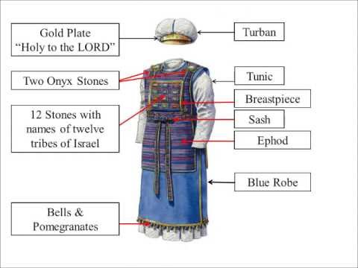
High Priest’s Garments

Slide 7
Sealed: Engraving
Breastplate with twelve stones:
Salvation: Embraced Possession
Ephod with two stones:
Spirit: Endued Power
Turban with Golden Plate:
Sanctification: Experience Process

Slide 8
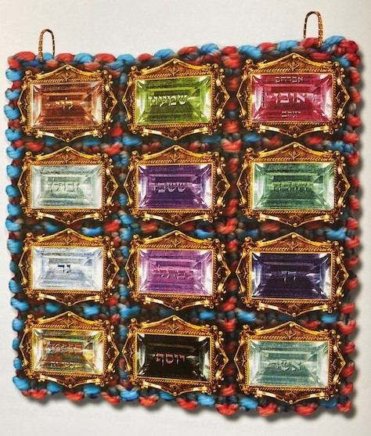
Breastplate with twelve stones

Slide 9
Salvation:
“Nevertheless the solid foundation of God stands, having this seal:
‘The Lord knows those who are His’, and, ‘Let everyone who names the name of Christ depart from iniquity.’”
(2 Timothy 2:19, NKJV)

Slide 10
At Salvation we are put into the spiritual nation of Israel:
“For he is not a Jew who is one outwardly, nor is circumcision that which is outward in the flesh; but he is a Jew who is one inwardly; and circumcision is that of the heart, in the Spirit, not in the letter; whose praise is not from men but from God.” (Romans 2:28–29, NKJV)
“but the Jerusalem above is free, which is the mother of us all.” (Galatians 4:26, NKJV)
“Now we, brethren, as Isaac was, are children of promise.” (Galatians 4:28, NKJV)

Slide 11
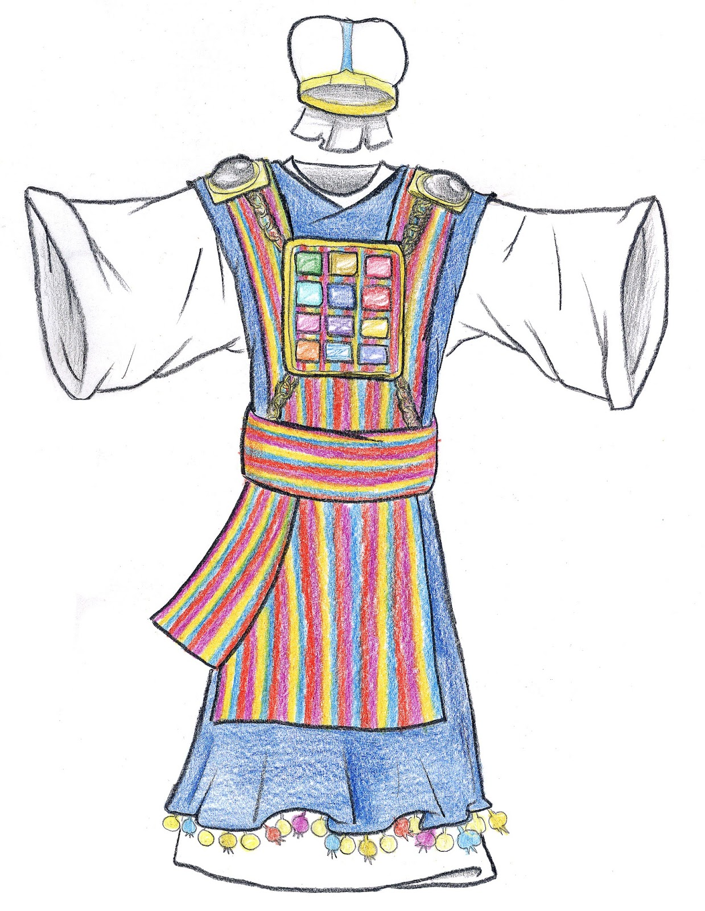
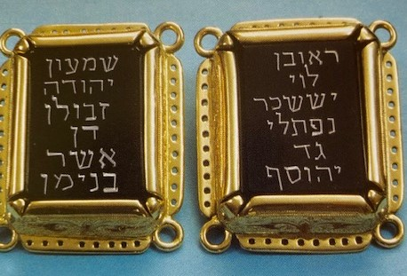
Ephod with two stones

Slide 12
Spirit Baptism:
“In Him you also trusted, after you heard the word of truth, the gospel of your salvation; in whom also, having believed, you were sealed with the Holy Spirit of promise,” (Ephesians 1:13, NKJV)
“And do not grieve the Holy Spirit of God, by whom you were sealed for the day of redemption.” (Ephesians 4:30, NKJV)
“who also has sealed us and given us the Spirit in our hearts as a guarantee.”
(2 Corinthians 1:22, NKJV)

Slide 13
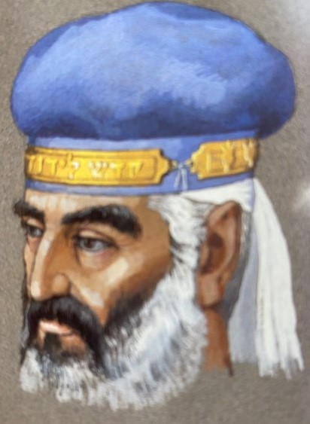
Turban with
Golden Plate

Slide 14
Holiness to the Lord
“Therefore gird up the loins of your mind, be sober, and rest your hope fully upon the grace that is to be brought to you at the revelation of Jesus Christ; as obedient children, not conforming yourselves to the former lusts, as in your ignorance; but as He who called you is holy, you also be holy in all your conduct, because it is written, “Be holy, for I am holy.””
(1 Peter 1:13–16, NKJV)

Slide 15
Holiness to the Lord
“For “who has known the mind of the Lord that he may instruct Him?” But we have the mind of Christ.”
(1 Corinthians 2:16, NKJV)
“Let this mind be in you which was also in Christ Jesus,” (Philippians 2:5, NKJV)
“And do not be conformed to this world, but be transformed by the renewing of your mind, that you may prove what is that good and acceptable and perfect will of God.” (Romans 12:2, NKJV)

Slide 16
Sealing in forehead
“Then I saw another angel ascending from the east, having the seal of the living God.
And he cried with a loud voice to the four angels to whom it was granted to harm the earth and the sea, saying,
“Do not harm the earth, the sea, or the trees till we have sealed the servants of our God on their foreheads.”
And I heard the number of those who were sealed. One hundred and forty-four thousand of all the tribes of the children of Israel were sealed:” (Revelation 7:2–4, NKJV)

Slide 17
Delivered:
“Then one of the elders answered, saying to me, “Who are these arrayed in white robes, and where did they come from?” And I said to him, “Sir, you know.” So he said to me,
“These are the ones who come out of the great tribulation, Exodus
and washed their robes and made them white in the blood of the Lamb. Passover, Priests
Therefore they are before the throne of God, and serve Him day and night in His temple. Ark
And He who sits on the throne will dwell among them. Cloud, presence
They shall neither hunger anymore nor thirst anymore; manna, water/rock
the sun shall not strike them, nor any heat; pillar of cloud and fire
for the Lamb who is in the midst of the throne will shepherd them Passover, ark
and lead them to living fountains of waters. And God will wipe away every tear from their eyes.”” Promised Land, Comfort (Revelation 7:13–17, NKJV)

