Slide 1
True Thanksgiving
Luke 17:11-19
www.kevinwearls.com

Slide 2
True Thanksgiving
1. Traveling the Rim
Now it happened as He went to Jerusalem that He passed through the midst of Samaria and Galilee.
2. Ten Repulsive Men
Then as He entered a certain village, there met Him ten men who were lepers, who stood afar off.

Slide 3
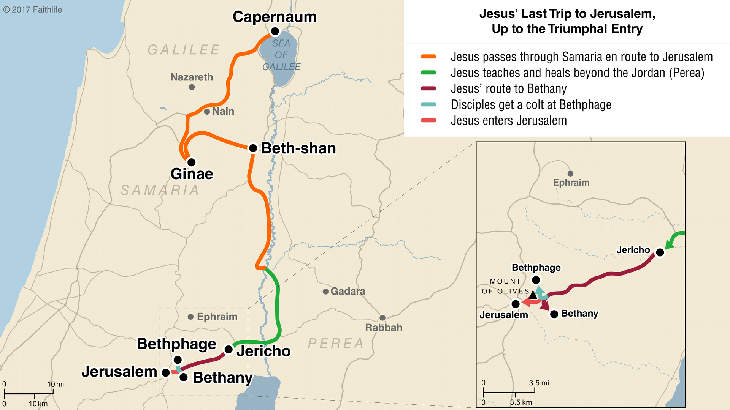

Slide 4
True Thanksgiving
3. The Request
And they lifted up their voices and said, “Jesus, Master, have mercy on us!”
4. The Reply
So when He saw them, He said to them, “Go, show yourselves to the priests.”

Slide 5
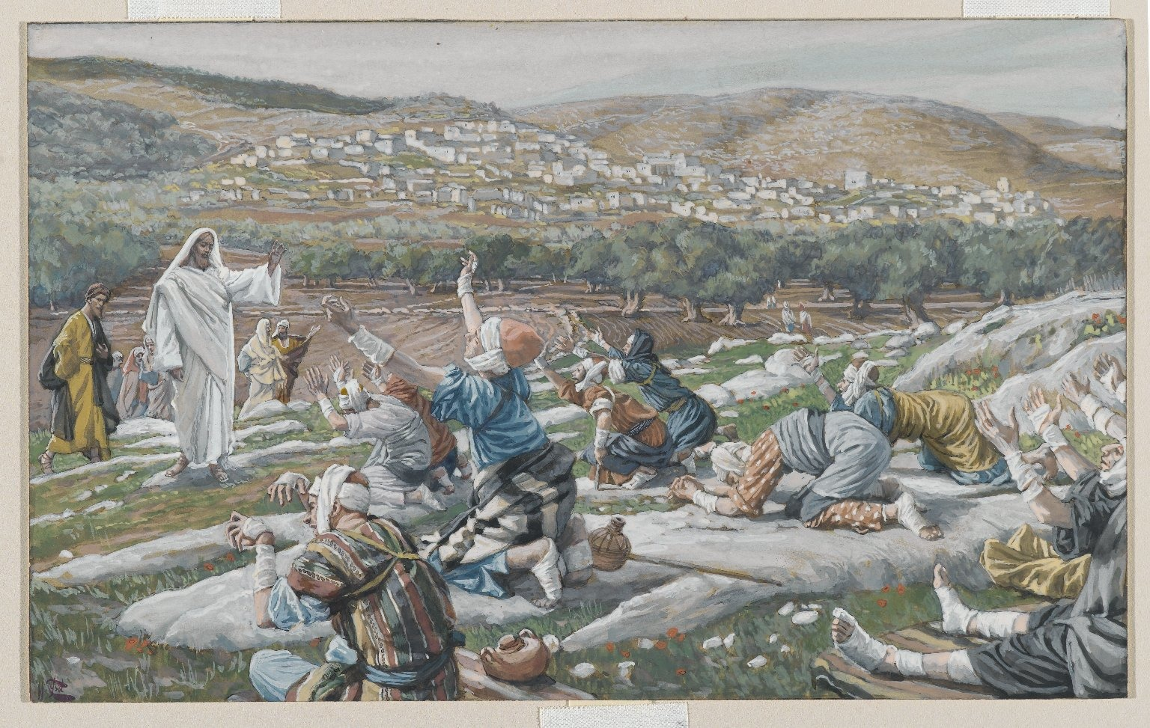

Slide 6
True Thanksgiving
5. The Restorative Work
And so it was that as they went, they were cleansed.
6. The Returning of One
And one of them, when he saw that he was healed, returned, and with a loud voice glorified God, and fell down on his face at His feet, giving Him thanks. And he was a Samaritan

Slide 7
True Thanksgiving
7. The Response
So Jesus answered and said,
  “Were there not ten cleansed?
  But where are the nine?
  Were there not any found who returned to give glory to God except this foreigner?”

Slide 8
Cyril of Alexandria:
Falling into a thankless forgetfulness, the nine lepers that were Jews did not return to give glory to God. By this, he shows that Israel was hard of heart and utterly unthankful. The stranger, a Samaritan, was of foreign race brought from Assyria.
The phrase “in the middle of Samaria and Galilee” has meaning. “He returned with a loud voice to glorify God.” It shows that the Samaritans were grateful but that the Jews, even when they benefited, were ungrateful.
Commentary on Luke, Homilies 113–16. Just, A. A. (Ed.). (2005). Luke (p. 269). Downers Grove, IL: InterVarsity Press.

Slide 9
The Value of Thanksgiving
Let’s consider the
mental,
moral and
spiritual value
of such a perpetual attitude.

Slide 10
The Value of Thanksgiving: Mental Value
To constantly keep in one’s mind thoughts of gratitude and thanksgiving is the greatest mental energizer ever discovered.

Slide 11
The Value of Thanksgiving: Moral Value
Being thankful has a distinct moral value, not only providing a mental tonic but a moral incentive.
1. Our gratitude to God provides a powerful motive to live lives that are well pleasing to Him.
2. Our gratitude to God makes us more willing to forgive others.

Slide 12
The Value of Thanksgiving: Spiritual Value
1. Thanksgiving magnifies God, and causes us to humble ourselves before Him.
2. A constant attitude of thanksgiving to God helps us to have a proper estimate of ourselves and an awareness of our dependence on God.
3. Thanksgiving is a sacrifice that God requires.
4. Thanksgiving gives meaning and power to our prayers.

Slide 13
True Thanksgiving
8. The Reward
And He said to him, “Arise, go your way.
    Your faith has made you well.”

Slide 14
True Thanksgiving
Traveling the Rim
Ten Repulsive Men
The Request
The Reply
The Restorative Work
The Return of One
The Response
The Reward

Slide 15
Thankful Starter List:
I am thankful for the “givens” in my life:
1. My parents: father and mother
2. My place in history
3. My ethnic background
4. My national heritage
5. My gender
6. My birth order
7. My brothers and sisters
8. My physical features
9. My mental capabilities
10. My journey of life

