Slide 1
The Second Touch
Gateway Christian Fellowship
August 10, 2025
www.kevinwearls.com

Slide 2
The Second Touch
Mark 8:1-38
1. The Provision 1-10
2. The Provoking 11-13
3. The Patience 14-21
4. The Power 22-26
5. The Prompting 27-30
6. The Prediction 31-38

Slide 3
4. The Power 22-26
And they came to Bethsaida. And some people brought a man who was blind to Jesus and begged Him to touch him.
Touch One: Taking the man who was blind by the hand, He brought him out of the village; and after spitting in his eyes and laying His hands on him, He asked him, “Do you see anything?” And he looked up and said, “I see people, for I see them like trees, walking around.”
Touch Two: Then again, He laid His hands on his eyes; and he looked intently and was restored, and began to see everything clearly.
And He sent him to his home, saying, “Do not even enter the village.”

Slide 4
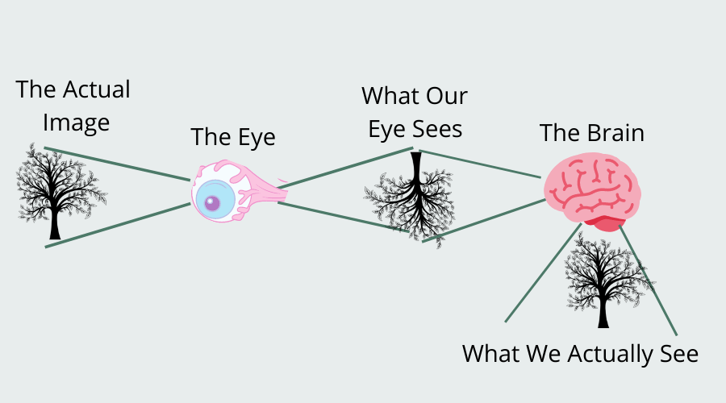

Slide 5
1. The Provision 1-10
Problem: “In those days, when there was again a large crowd and they had nothing to eat, Jesus summoned His disciples and said to them,
Pity: “I feel compassion for the people because they have remained with Me for three days already and have nothing to eat. And if I send them away hungry to their homes, they will faint on the way; and some of them have come from a great distance.”

Slide 6
1. The Provision 1-10
Pessimism: And His disciples replied to Him, “Where will anyone be able to find enough bread here in this desolate place to satisfy these people?” And He was asking them, “How many loaves do you have?” And they said, “Seven.”
Placement: And He directed the people to recline on the ground; and taking the seven loaves, He gave thanks and broke them, and started giving them to His disciples to serve, and they served them to the people. They also had a few small fish; and after He had blessed them, He told the disciples to serve these as well. And they ate and were satisfied; and they picked up seven large baskets full of what was left over of the broken pieces. About four thousand men were there; and He dismissed them.
And immediately He got into the boat with His disciples and came to the region of Dalmanutha.

Slide 7
2. The Provoking 11-13
Demand: And the Pharisees came out and began to argue with Him, demanding from Him a sign from heaven, to test Him.
Denial: Sighing deeply in His spirit, He said, “Why does this generation demand a sign? Truly I say to you, no sign will be given to this generation!”
And leaving them, He again embarked and went away to the other side.

Slide 8
3. The Patience 14-21
And the disciples had forgotten to take bread, and did not have more than one loaf in the boat with them.
Caution: And He was giving orders to them, saying, “Watch out! Beware of the leaven of the Pharisees, and the leaven of Herod.”
Confusion: And they began to discuss with one another the fact that they had no bread.

Slide 9
3. The Patience 14-21
Clarification: And Jesus, aware of this, said to them, “Why are you discussing the fact that you have no bread? Do you not yet comprehend or understand? Do you still have your heart hardened? having eyes, do you not see? and having ears, do you not hear?
And do you not remember, when I broke the five loaves for the five thousand, how many baskets full of broken pieces you picked up?” They said to Him, “Twelve.” “When I broke the seven for the four thousand, how many large baskets full of broken pieces did you pick up?” And they said to Him, “Seven.”
And He was saying to them, “Do you not yet understand?”

Slide 10
5. The Prompting 27-30
Probing: Jesus went out, along with His disciples, to the villages of Caesarea Philippi; and on the way He questioned His disciples, saying to them, “Who do people say that I am?” They told Him, saying, “John the Baptist; and others say Elijah; and others, one of the prophets.” And He continued questioning them: “But who do you say that I am?”
Perception: Peter answered and said to Him, “You are the Christ.”
And He warned them to tell no one about Him.

Slide 11
6. The Prediction 31-38
Revealing: And He began to teach them that the Son of Man must suffer many things and be rejected by the elders and the chief priests and the scribes, and be killed, and after three days rise from the dead. And He was stating the matter plainly.
Rebukes: And Peter took Him aside and began to rebuke Him.
But turning around and seeing His disciples, He rebuked Peter and said, “Get behind Me, Satan; for you are not setting your mind on God’s purposes, but on man’s.”

Slide 12
6. The Prediction 31-38
Requirements: And He summoned the crowd together with His disciples, and said to them, “If anyone wants to come after Me, he must deny himself, take up his cross, and follow Me.
Rewards: For whoever wants to save his life will lose it, but whoever loses his life for My sake and the gospel’s will save it.
For what does it benefit a person to gain the whole world, and forfeit his soul? For what could a person give in exchange for his soul?
For whoever is ashamed of Me and My words in this adulterous and sinful generation, the Son of Man will also be ashamed of him when He comes in the glory of His Father with the holy angels.””

Slide 13
The Second Touch
Second feeding of a crowd (4000+)
Those who thought they were Second in charge
The Half blind disciples
The Half cure, then the Second touch
The Half seeing disciples
The Half understood requirements
We need the Second Touch from the Lord

Slide 14


